Slide 1

How to draw a system diagram
Project Management Unit #2a

Slide 2
Basic Steps
Identify all major components
  These are your subsystems
  Derived from your project goal, objectives and requirements
Identify all interfaces between components
  These are either relationships or real connections between components
Produce your drawing
  Components are labeled boxes
  Interfaces are arrowed lines keyed to the interface function
  Keep your layout as straight forward as possible

Slide 3
Identify Major Components
Components are based upon the project goal, objectives and requirements:
  To measure something you need a Sensor Subsystem
  To store your data you need a Data Archive Subsystem
  For your payload to operate by itself during flight you need a Control Subsystem
  To enable your payload to operate you need a Power Subsystem
  To keep your payload from falling apart you need a Mechanical Support Subsystem
  To keep your experiment at the correct temperature you need a Thermal Control Subsystem
  To analyze your data offline you need a Ground Support Subsystem
More or different kinds of subsystems might be required
You also need to understand where these subsystems are located

Slide 4
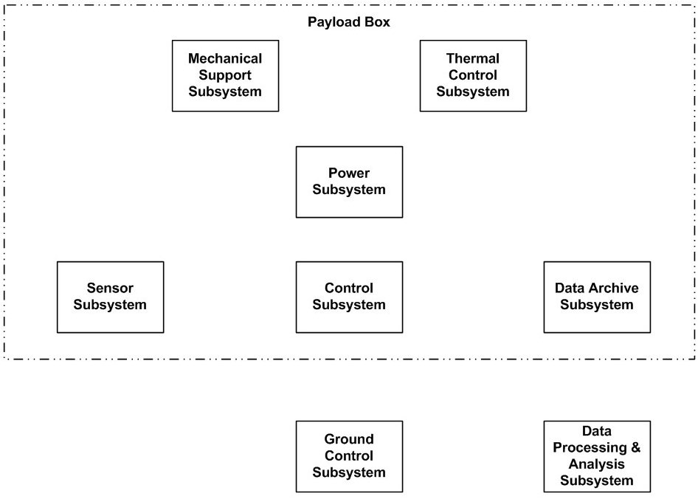
Example Component Drawing
Each sub-system has its own box
Components are arranged in a logical order
Components are grouped according to their relational location

Slide 5
Determine the interfaces
Interfaces are the “connections” between the components
  Could be a physical connection (e.g. wire, bolt)
  Could be a relationship / property (e.g. temperature, light)
Each unique interface should be represented by a different kind of line
Each interface should be labeled according to its specific characteristics
Arrows on the ends of the line indicate flow

Slide 6
Interface representations
Interfaces types
  Power
  Data
  Control
  Mechanical
  Thermal
Interface flow
  To component
  From component
  Bi-directional

Slide 7
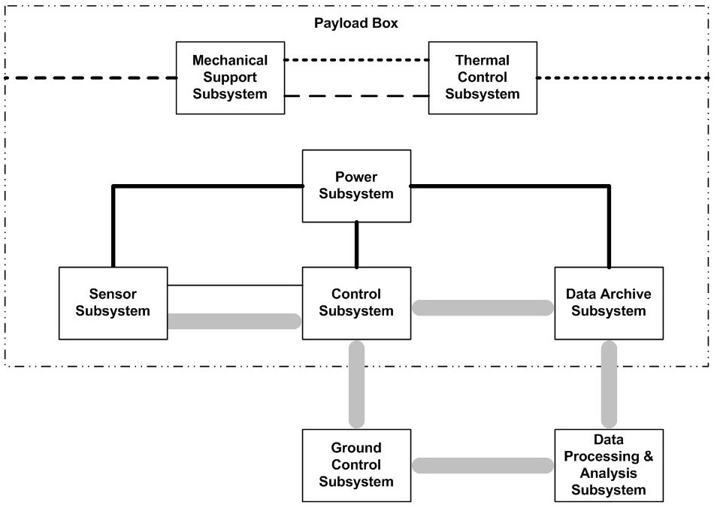
Add the interfaces

Slide 8
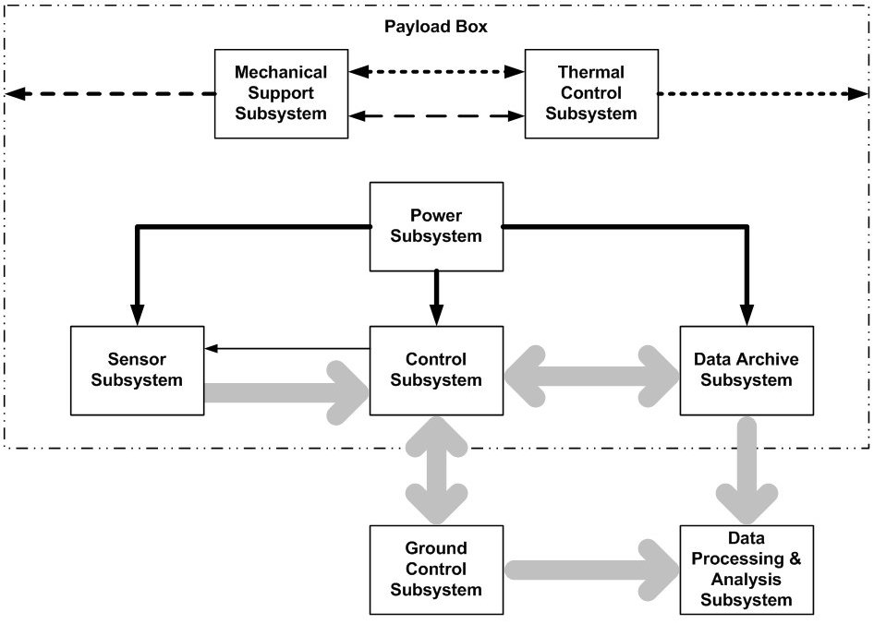
Indicate the interface flow

Slide 9
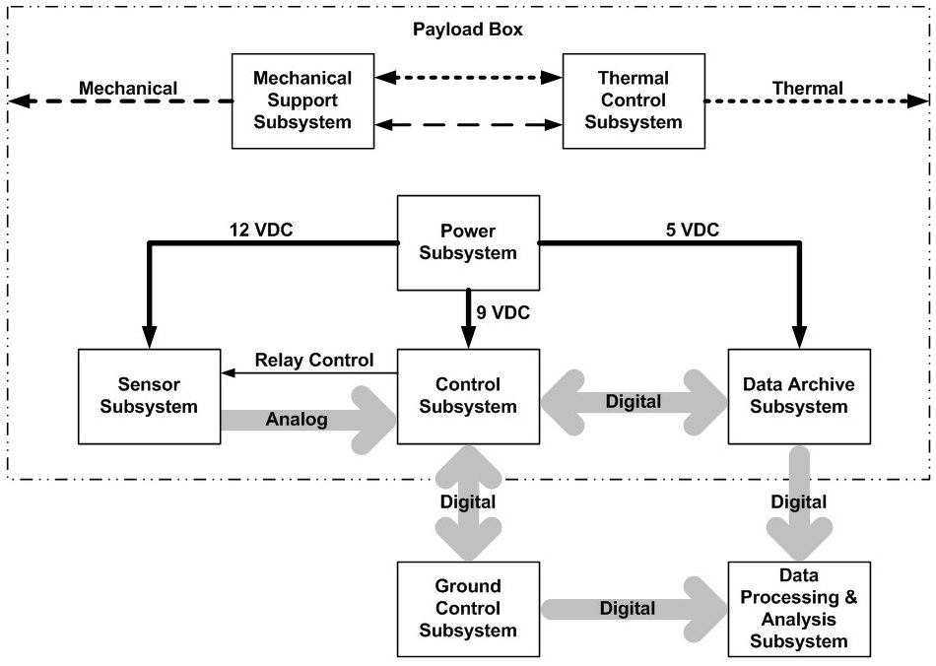
Complete the labeling

